Slide 1
Code Review Training Course. Part 6b: CTF Write-up
For VIB only
namhabach@gmail.com

Slide 2

Web challenges in CTF

Slide 3
Built-in Safe Function
Blind belief is dangerous

Slide 4
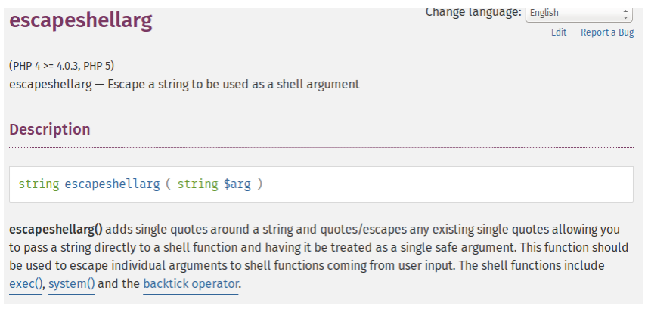
Built-in Safe Function

Slide 5
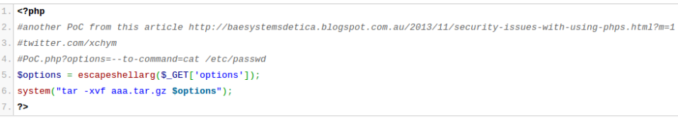
Built-in Safe Function

Slide 6
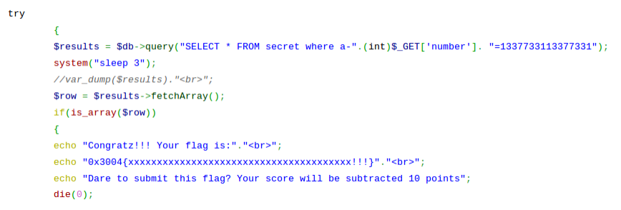
Built-in Safe Function
Sometimes casting input to INT can not protect you from SQL injection

Slide 7
Race Condition
Ghost In The Shellcode 2015 CTF
Aart web-200

Slide 8
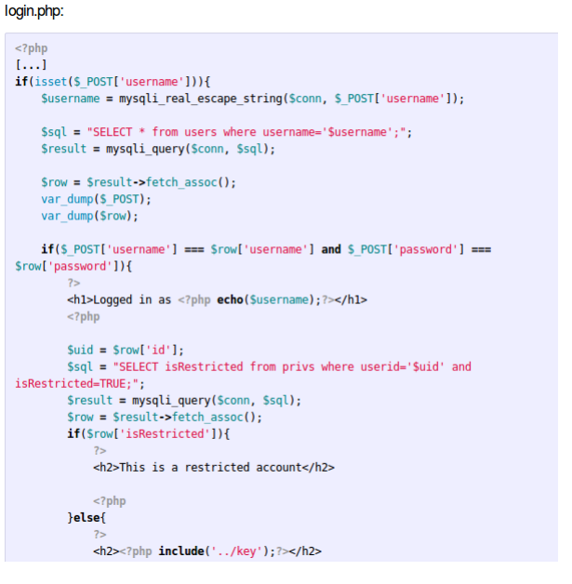
Ghost In The Shellcode 2015 CTF: Aart

Slide 9
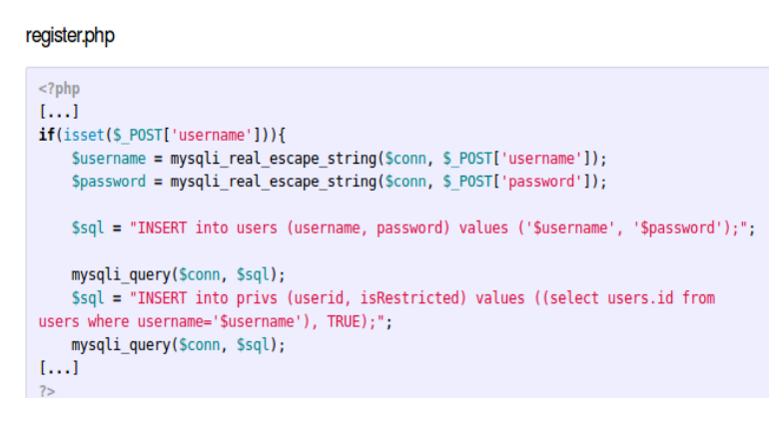
Ghost In The Shellcode 2015 CTF: Aart

Slide 10
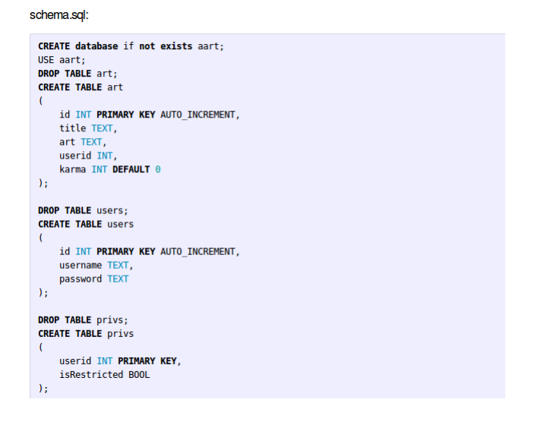
Ghost In The Shellcode 2015 CTF: Aart

Slide 11
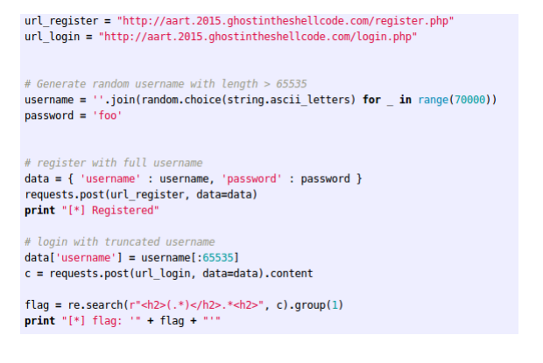
Ghost In The Shellcode 2015 CTF: Aart
Exploit 1: Username truncation

Slide 12
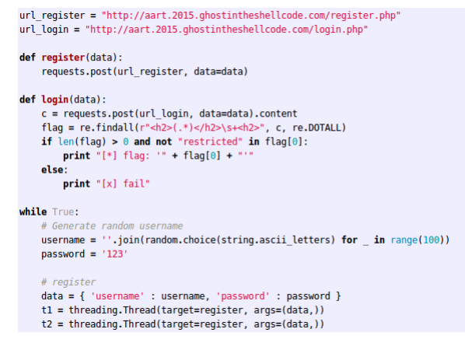
Ghost In The Shellcode 2015 CTF: Aart
Exploit 2: Race condition - Double registration

Slide 13
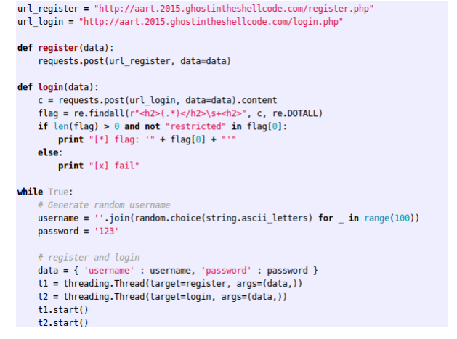
Ghost In The Shellcode 2015 CTF: Aart
Exploit 3: Race Condition - Login before privileges inserted

Slide 14
Questions?

Slide 15
Link Feedback: http://goo.gl/forms/3nSVOcfZfQ
#poweroff
End of Part 6b
End of Course…..
System is halt now!!!

